Slide 1
Creating Your Constitution
Streamline your process of maintaining a style guide
Notes:
From Logan UT.
If everyone agrees on the process by which we create a style guide, and all the historical voting records are kept up to date,
you thereby create a way to make what seems impossible possible and you do your organization a huge favor in the process by creating a living style guide that can be iterated on over the years
and that anyone can propose changes to at any time.
All the rest will follow. This model scales across teams as well,
I plan to give examples of how to get started and how to do the
historical record keeping, etc.
So many good ideas go unimplemented simply because there is not a perfect process in place to capture them and process them.
Get everyone to agree on the lower level rules
First attempt at a style guide was not super official and/or it lacked buy-in from everyone
All this led me to conclude that the real first step in starting a style guide is actually first defining a process by which anyone can propose changes, modify existing changes, or object to changes and a document governing the voting rules.
If you start here it should it should make it a lot easier to find common ground among teams, it sets the record straight so that nobody can complain if something doesn’t go their way because they agreed to the process to begin with, and it can actually be a lot of fun.
From there, your style guide should be self executing and self documenting pretty much. This idea even scales across teams, just like federal and state constitutions. Define one over-arching “federal” constitution with say the team leads, then let each team define their own “state” constitution.

Slide 2
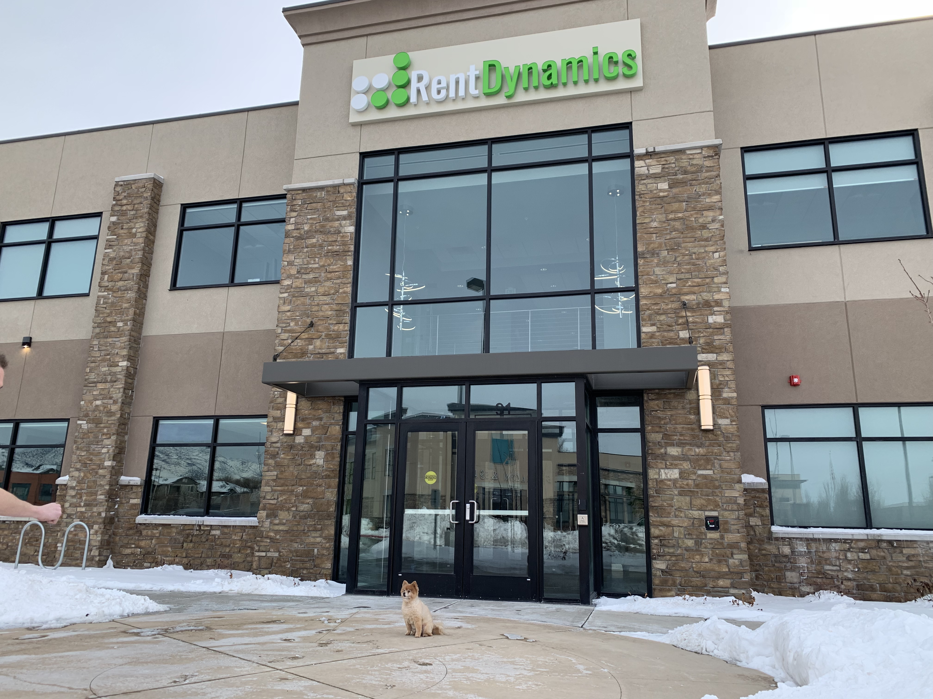


8 years at Rent Dynamics
Sr Software Team Lead over Contact Center Development
Part-time property manager on my off time

Slide 3
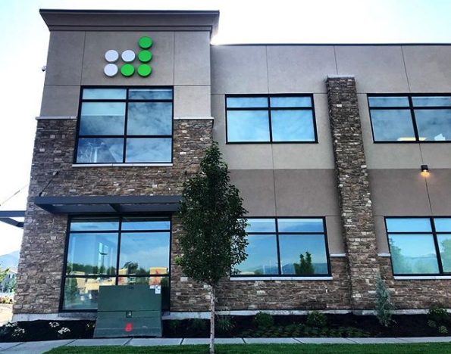

Notes:
fun fact, turbo has worked at rent dynamics for 5 years

Slide 4


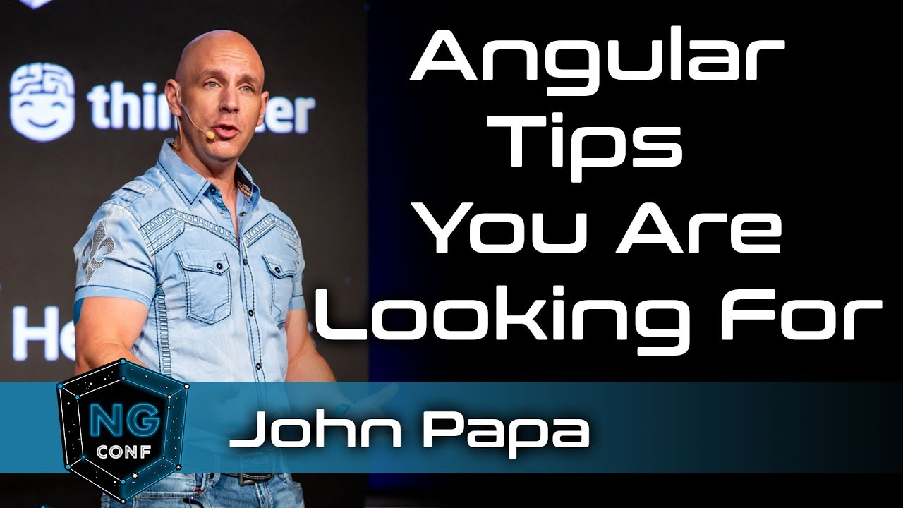
Notes:
Jon Papa is awesome
King of style guides
If jon papa tells you to do something, you probably better do it.

Slide 5
Why we need a style guide
Consistency
Maintainability
Notes:
Can't do it all by yourself, need buy in from everybody.
DEBATES
Even finding minimal common ground to start a style guide can be super challenging
Rxjs vs promises
Ngrx vs not
Cypress vs Selenium
- Buy-in from everybody

Slide 6
Standup
Not “Official”
No historical record keeping
Notes:
So many good ideas go unimplemented simply because they are not channeled correctly.

Slide 7
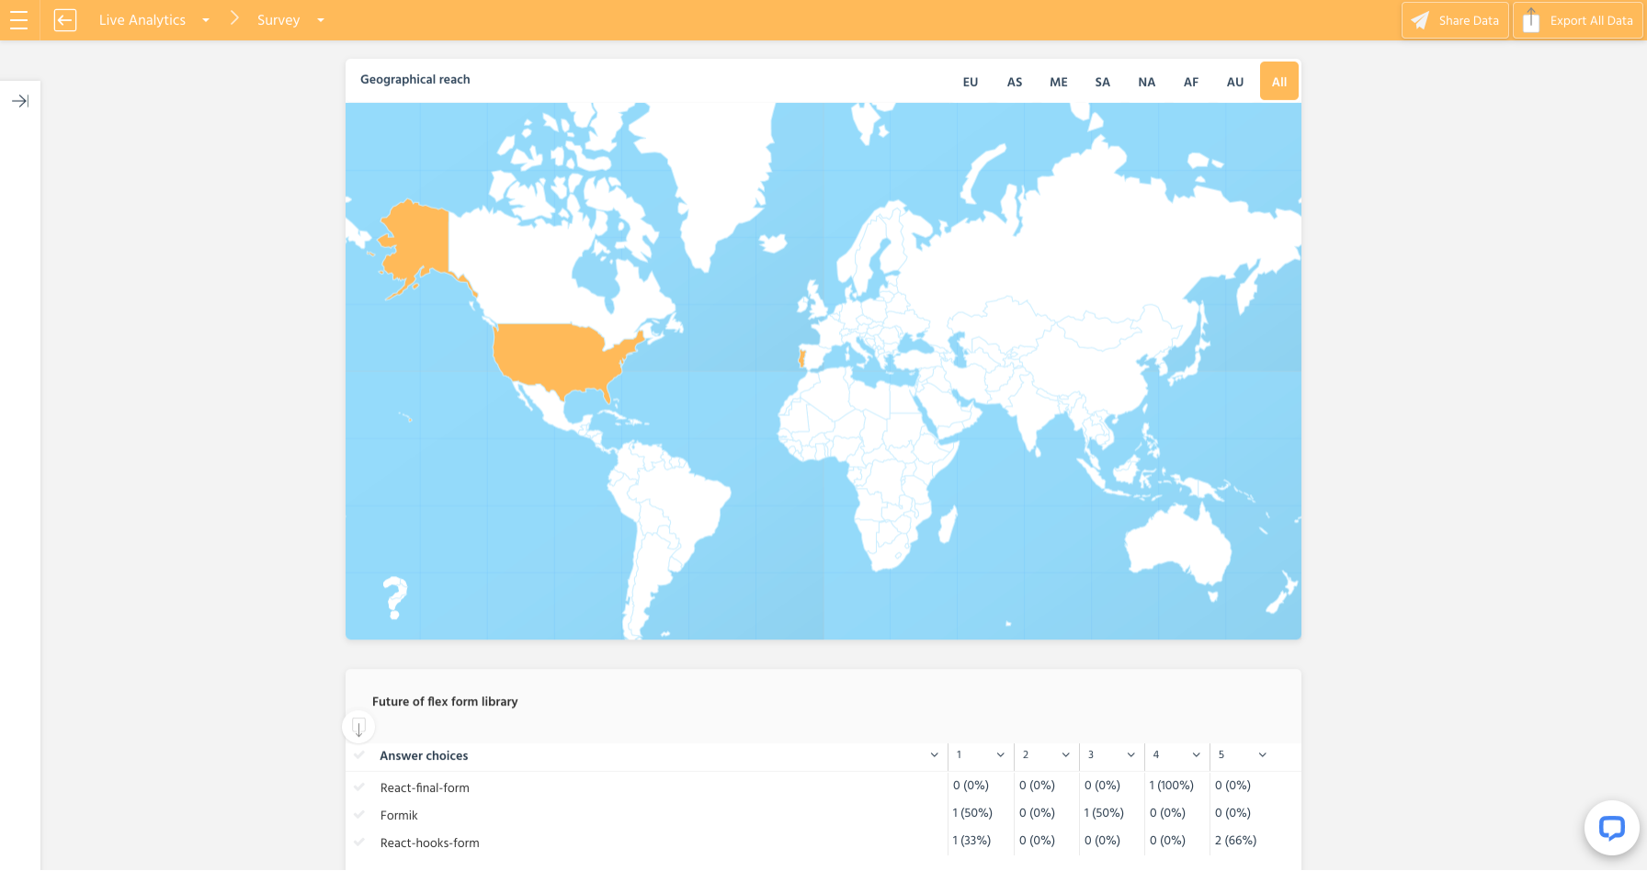
1st Vote
Notes:
More Angular experience than react experience
Get everyone to agree on the lower level rules

Slide 8
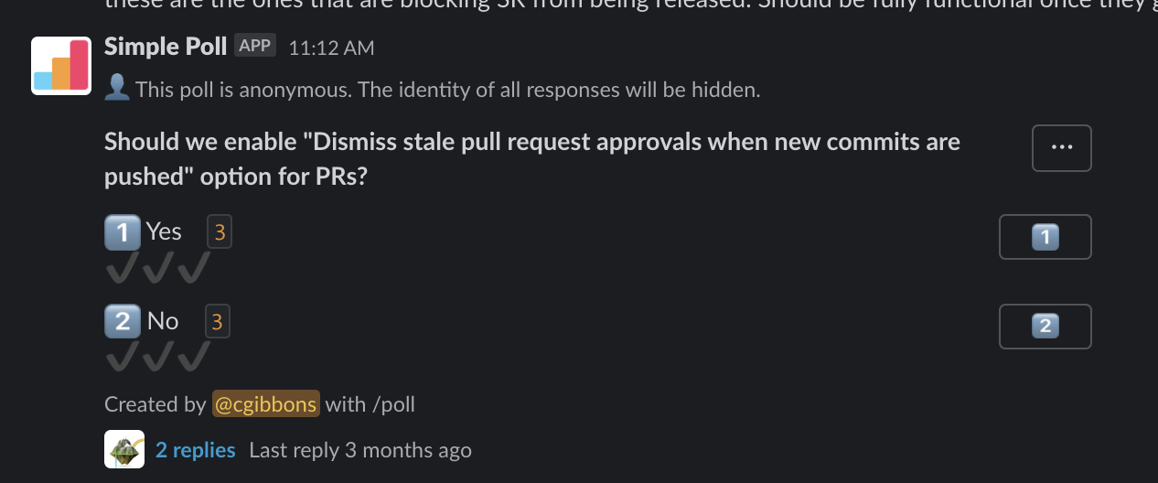
2nd Vote

Slide 9
Ideal solution
Must be “Official”
Historical record keeping is a must
Any new rule must have authority/buy-in from everyone
Should avoid conflict/No chance of stalemate
Should avoid ambiguity
Everyone should know exactly what changes were made, when they were made,
and why
Everyone should know how to propose their own changes
Everyone should be able to vote on new changes
Should work across teams and/or within teams

Slide 10
Contracts are super useful
Contracts and amendments in general are really good at defining clear processes upfront and making things “official”
Contracts are also helpful in that they provide an area of common ground for what can otherwise be two or more hostile parties. (Single source of truth)
Iterative in nature/Self documenting
Always customizable
Constitution == Type of Contract
Notes:
DEBATES
Even finding minimal common ground to start a style guide can be super challenging
Rxjs vs promises
Ngrx vs not
Cypress vs Selenium
- Buy-in from everybody

Slide 11
“If everyone agrees to the process by which we make changes to our style guide, if everyone agrees to the voting standards, voting thresholds, etc, (the constitution) and if everything is tracked in a transparent open manner—then everyone should be compelled to follow the style guide even if they get out-voted on any particular rule.”
Notes:
Get everyone to agree on the lower level rules

Slide 12

Demo
https://github.com/turbonemesis/constitution

Slide 13
Thank You
Evergreen
Scalable
Opinionated
Automated
Fun Activity
Powerful
It’s just an idea, but the beauty of this idea is it harnesses other people’s ideas and allows them to flourish
https://github.com/turbonemesis/constitution
https://chasegibbons.com

